Slide 1
The Logic of Experimental verifiability
Assumptions of Physics collaboration

Slide 2
Outline
Issue fundamental object (in math is a set)
Science is about describing the world, but not all descriptions of the world are science
Require -> Principle of scientific objectivity (examples of non-universal, contradictory, non-verifiable or semi-decidable)
Two parts: first solve non-contradiction, then solve evidence based
Statements
Problem of web of meaning, and idealization of statements (“conceptual cut”) -> statements being prime objects (i.e. unstructured)
Show the divide between formal and informal
Need justifications for axioms and definitions; axioms and definitions are chosen because they allow for simple justification (not because mathematicians like them)
Problems in capturing self-consistency (paradoxes, semantic and formal) -> Axiom of context
Truth is found experimentally, it has to be consistent with the meaning of the statements -> Axiom of possibility
Dependency between statements -> Axiom of closure
Logic operations, Equivalence (different equivalence), Boolean algebra, Narrowness and independence, minterms
Verifiable
Finite time verification (also idealization) – Not convenient to formalize the tests (knowing what is testable assumes knowing the laws of physics – circularity!)
Axiom of verifiability
Problem with NOT – falsifiable/decidable
Axioms of finite conjunction, countable disjunction
Summary of the logic

Slide 3
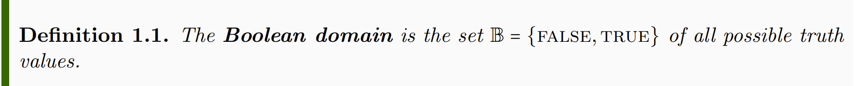
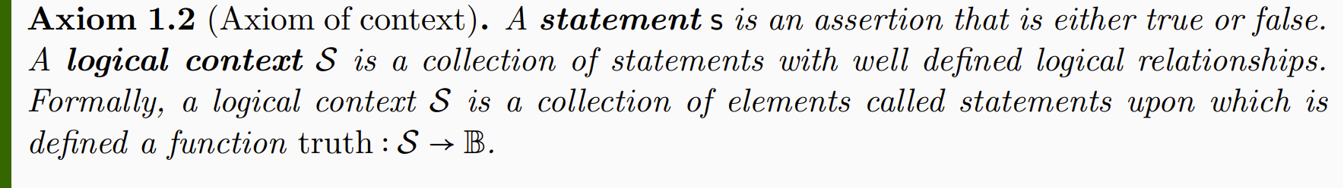
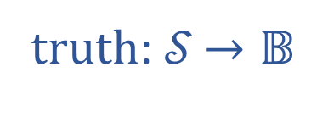

Informal part
Formal part
truth: 𝒮 $→𝔹$
𝒮
$$𝔹$$

Slide 4
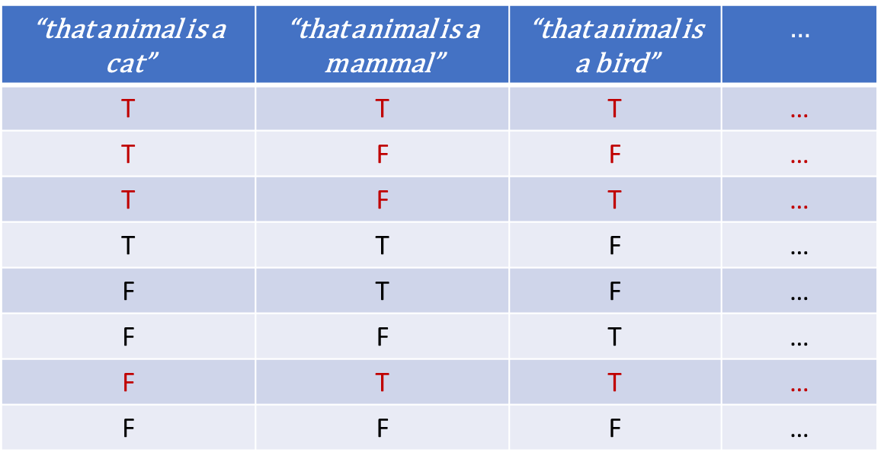
Not all combinations of truth values are logically possible
“that animal is a cat” | “that animal is a mammal” | “that animal is a bird” | $$…$$
T | T | T | …
T | F | F | …
T | F | T | …
T | T | F | …
F | T | F | …
F | F | T | …
F | T | T | …
F | F | F | …
The semantic content of the statement is captured by what combinations, or assignments, are possible
Notes:
Part of the semantic content of the statements is captured by what truth value can be assigned; Possible assignments are determined by the semantic content of the statements

Slide 5
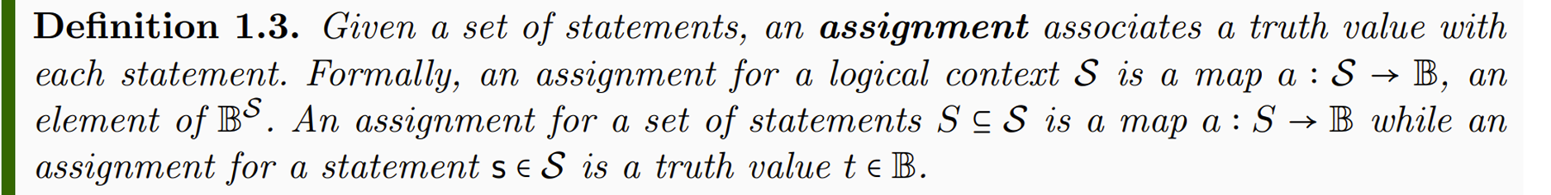
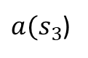
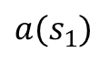
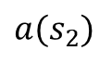
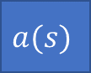

$$s_{1}$$ | $$s_{2}$$ | $$s_{3}$$ | …
$$a(s)$$
T | T | F | …
$$a(s_{1})$$
$$a(s_{2})$$
$a(s_{3}$)
Notes:
TODO: Add a … after the third statement

Slide 6
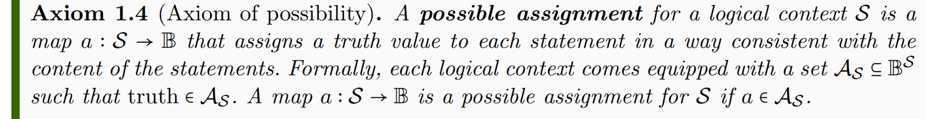


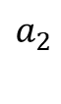
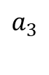
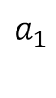
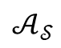
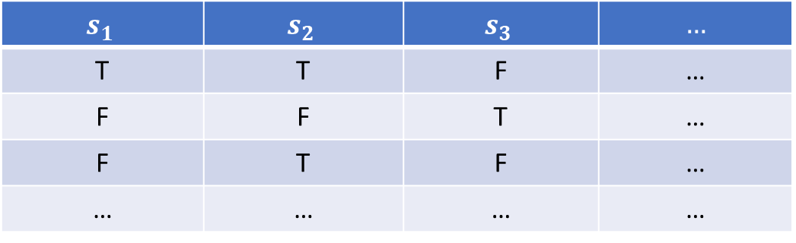
$$s_{1}$$ | $$s_{2}$$ | $$s_{3}$$ | $$…$$
T | T | F | …
F | F | T | …
F | T | F | …
… | … | … | …
$$a_{1}$$
$$a_{2}$$
$$𝒜_{𝒮}$$
$$a_{3}$$
$$…$$

Slide 7
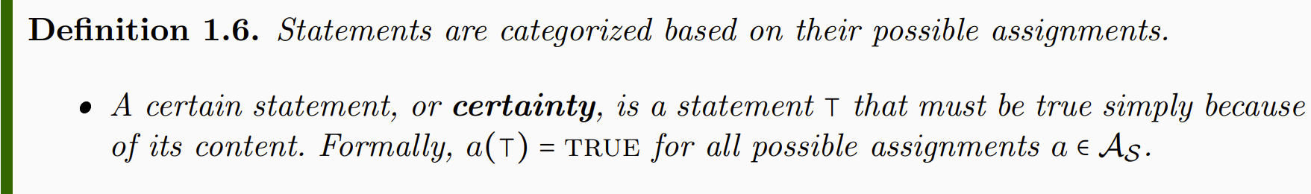
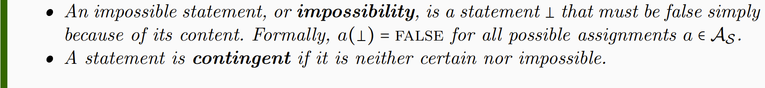
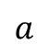
“that cat is a mammal” | “that mammal is a cat” | “that mammal is a bird”
T | T | F
T | F | F
T | F | F
T | T | F
… | … | …
$$a$$
Notes:
NOTE: whether a statement is a certainty or not depends on context. Mass of the electron: contingent if measuring the mass, certainty for particle identification

Slide 8
Notes:
Want to keep track whether the truth of one statement depends on the truth of others: function on truth values – introduce truth tables

Slide 9
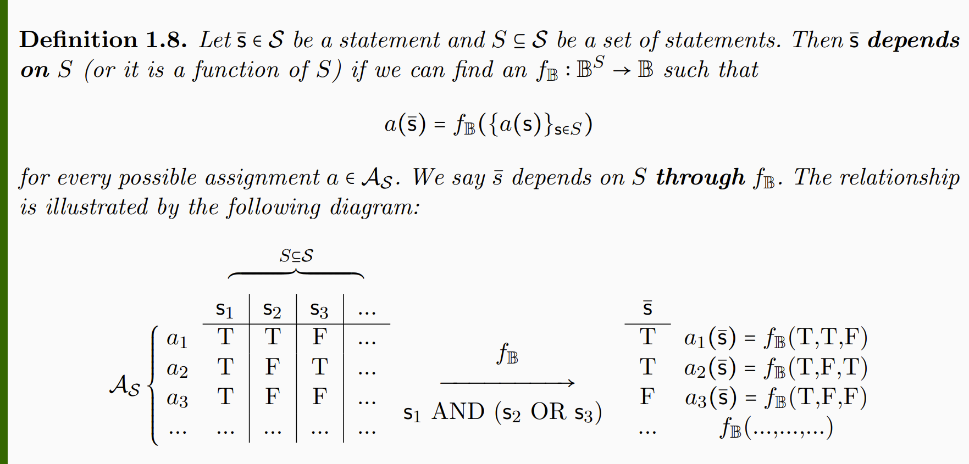
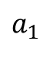
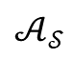
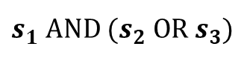
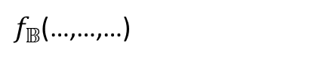
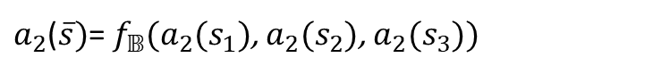
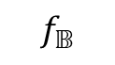

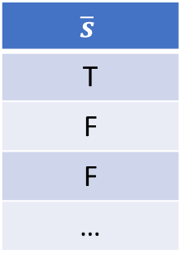
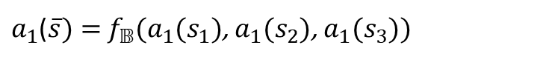
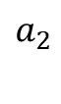
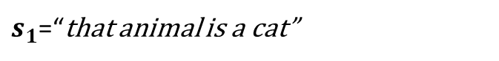
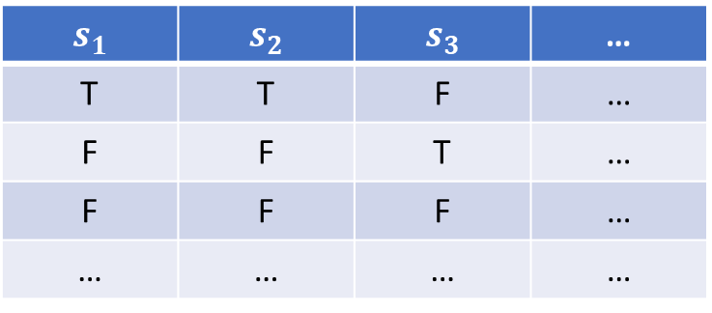
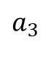
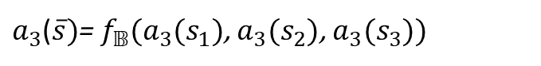
$$S$$
$$s_{1}$$ | $$s_{2}$$ | $$s_{3}$$ | …
T | T | F | …
F | F | T | …
F | F | F | …
… | … | … | …
$$\overline{s}$$
T
F
F
…
$$a_{1}$$
$a_{1}$($\overline{s})=$ $f_{𝔹}(a_{1}(s_{1})$, $a_{1}(s_{2}$), $a_{1}(s_{3}$))
$$a_{2}$$
$$f_{𝔹}$$
$a_{2}$($\overline{s})$= $f_{𝔹}(a_{2}(s_{1})$, $a_{2}(s_{2}$), $a_{2}(s_{3}$))
$$𝒜_{𝒮}$$
$$a_{3}$$
$s_{1}$ AND ${(s}_{2} OR{ s}_{3})$
$a_{3}$($\overline{s})$= $f_{𝔹}(a_{3}(s_{1})$, $a_{3}(s_{2}$), $a_{3}(s_{3}$))
$$…$$
$f_{𝔹}$(…,…,…)
$s_{1}$=“that animal is a cat”
$s_{2}$=“that animal is a mammal”
$s_{3}$=“that animal is a bird”
Notes:
Applying truth tables to the assignments

Slide 10
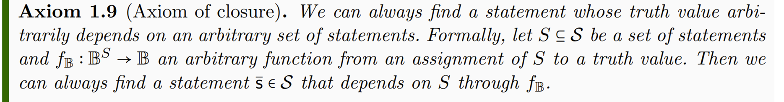


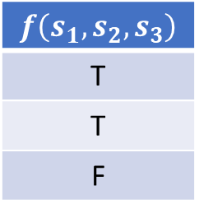
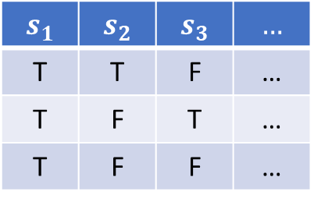
$$s_{1}$$ | $$s_{2}$$ | $$s_{3}$$ | $$…$$
T | T | F | …
T | F | T | …
T | F | F | …
$$f\left(s_{1},s_{2},s_{3}\right)$$
T
T
F
$$f_{𝔹}$$
Notes:
The logical context will allows allow all possible truth functions

Slide 11
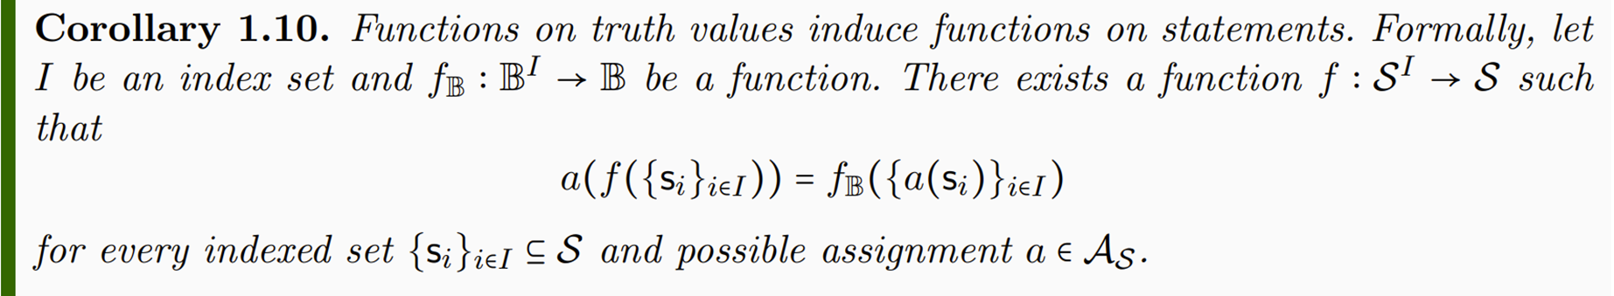

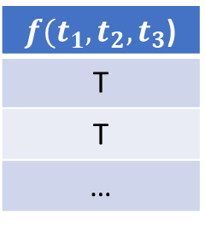
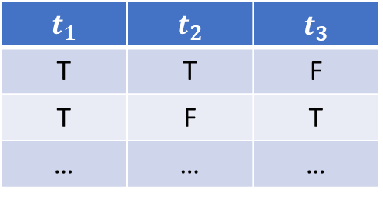
$$t_{1}$$ | $$t_{2}$$ | $$t_{3}$$
T | T | F
T | F | T
… | … | …
$f(t_{1},t_{2},t_{3}$)
T
T
…
Notes:
-> Functions on truth values induce functions on statements

Slide 12
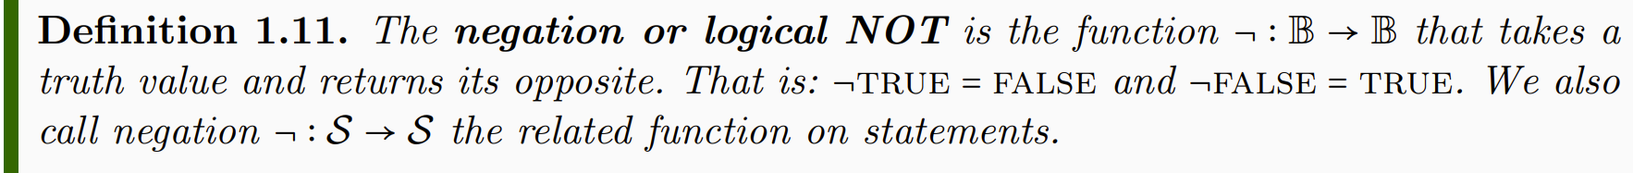
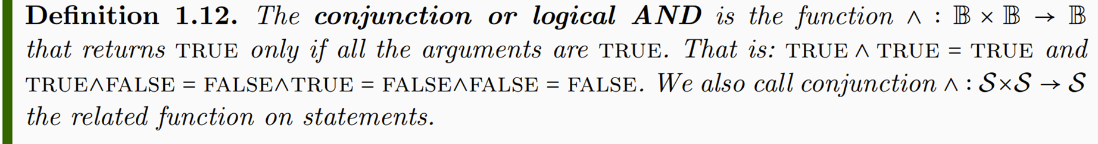
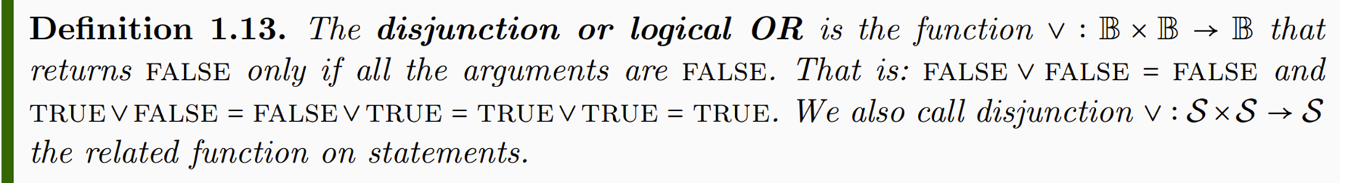
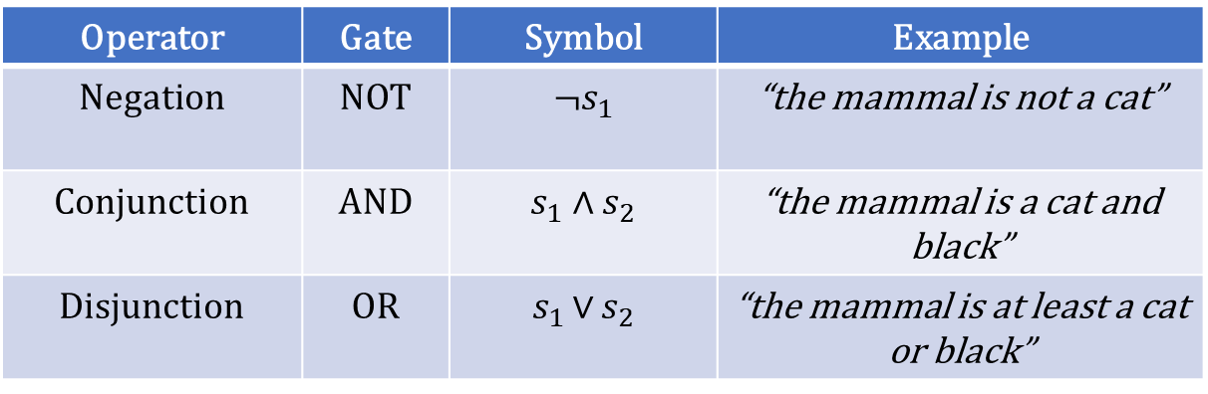
Operator | Gate | Symbol | Example
Negation | NOT | ¬$s_{1}$ | “the mammal is not a cat”
Conjunction | AND | $$s_{1} \text{∧ }s_{2}$$ | “the mammal is a cat and black”
Disjunction | OR | $s_{1 }\text{∨}$ $s_{2}$ | “the mammal is at least a cat or black”

Slide 13
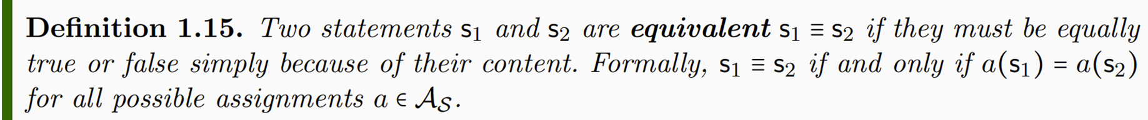
Notes:
Different notion of equivalence Table 1.2

Slide 14
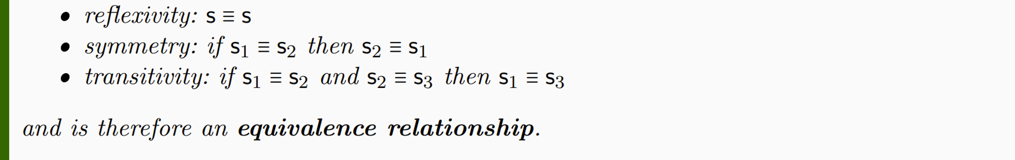
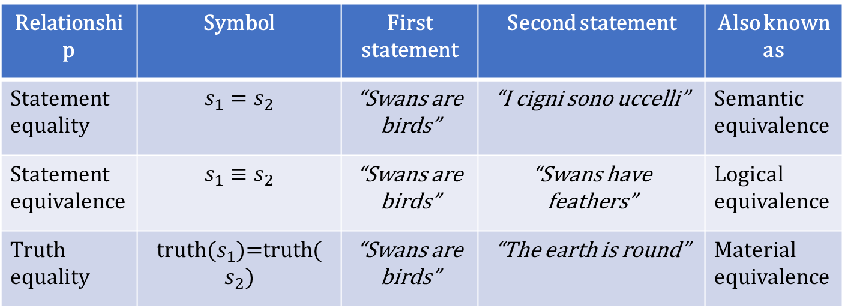
Relationship | Symbol | First statement | Second statement | Also known as
Statement equality | $$s_{1}=s_{2}$$ | “Swans are birds” | “I cigni sono uccelli” | Semantic equivalence
Statement equivalence | $$s_{1}≡s_{2}$$ | “Swans are birds” | “Swans have feathers” | Logical equivalence
Truth equality | truth($s_{1}$)=truth($s_{2})$ | “Swans are birds” | “The earth is round” | Material equivalence

Slide 15
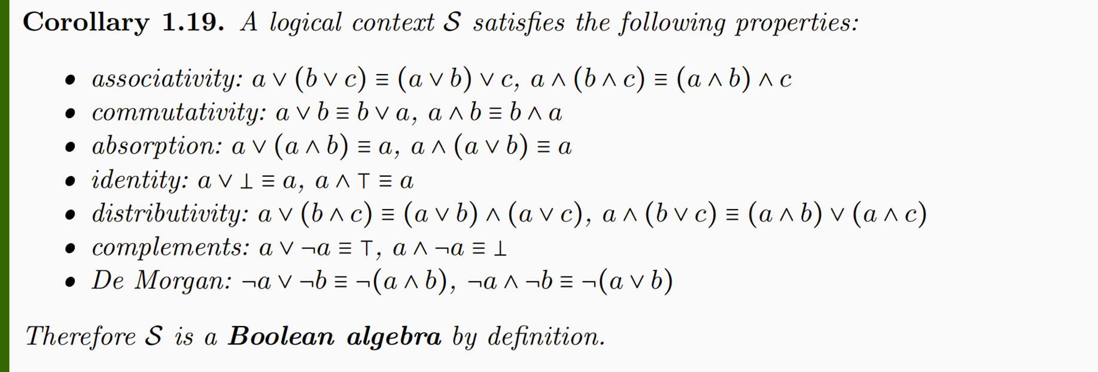

Slide 16
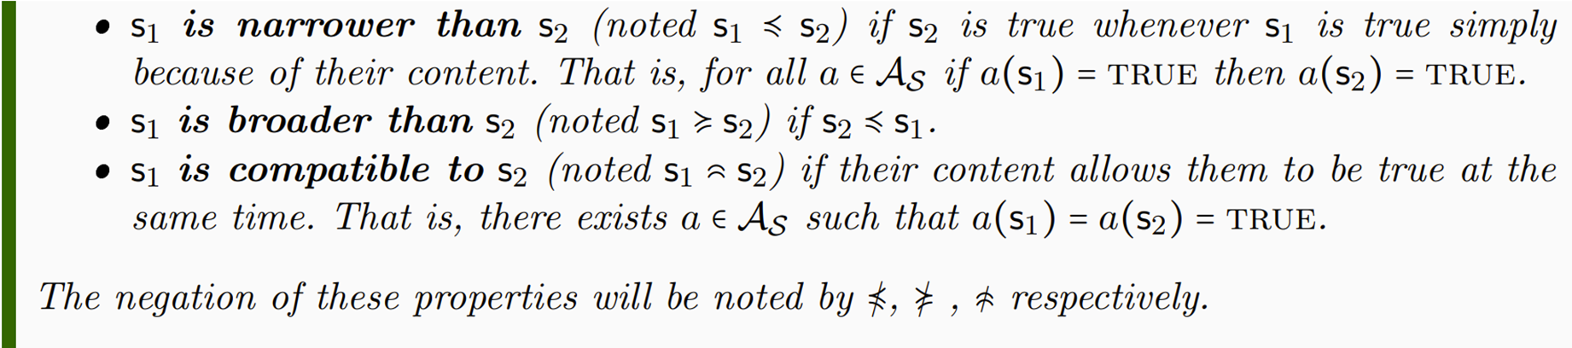
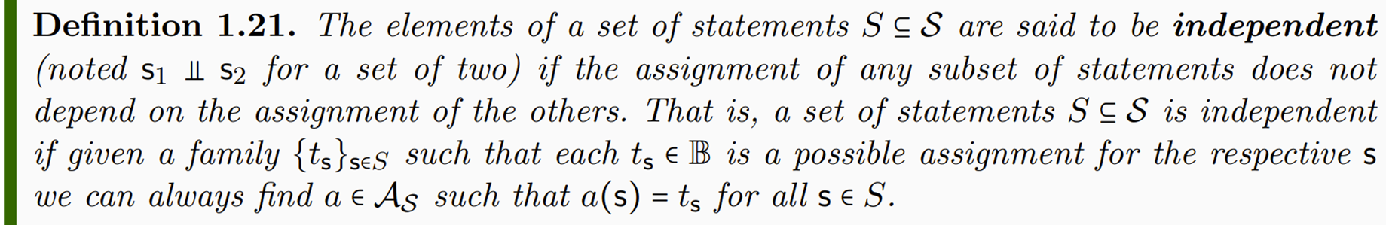

Slide 17
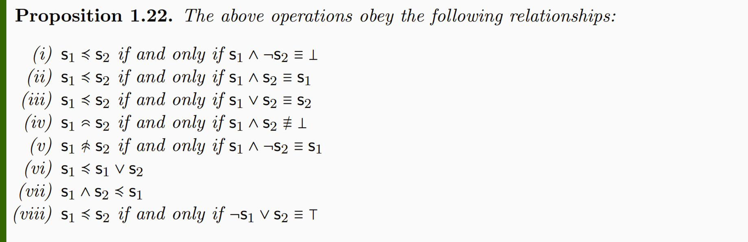

Slide 18
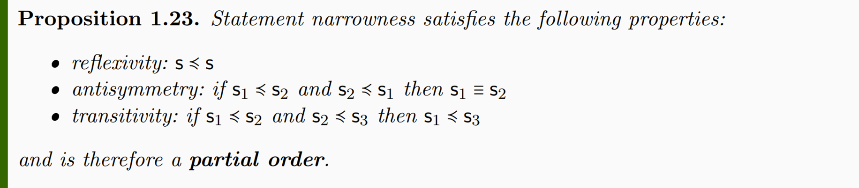



Slide 19


